Slide 1
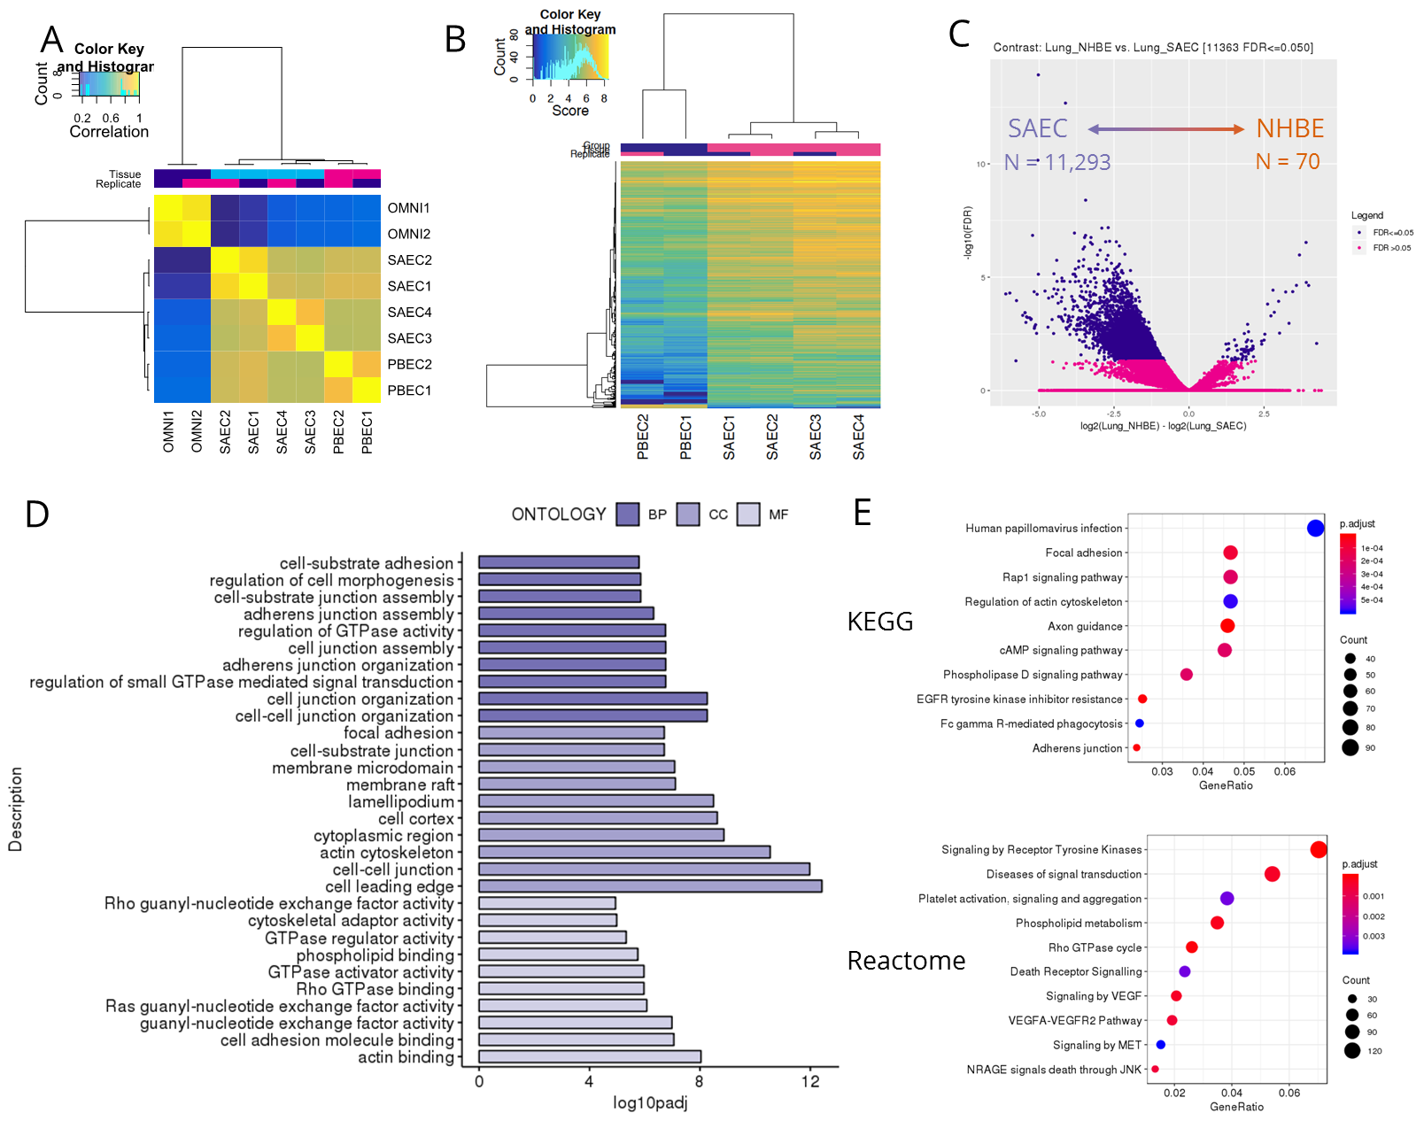
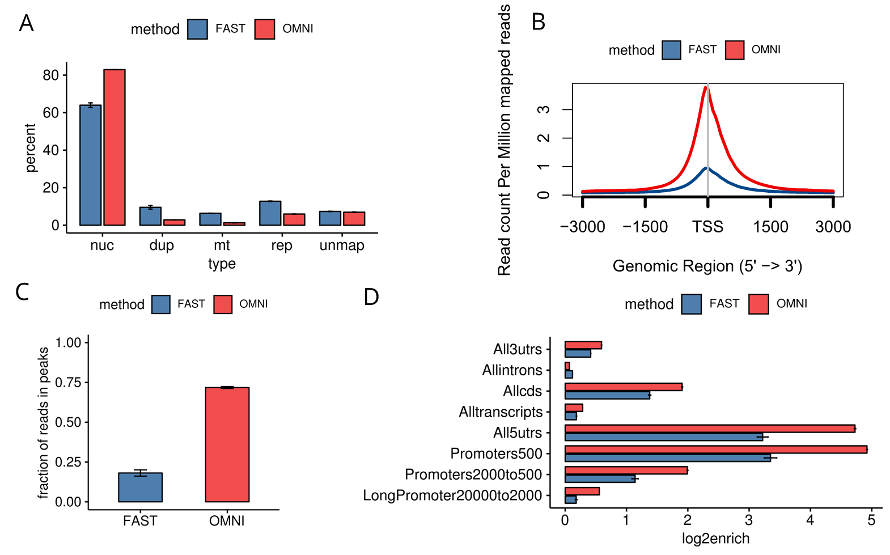
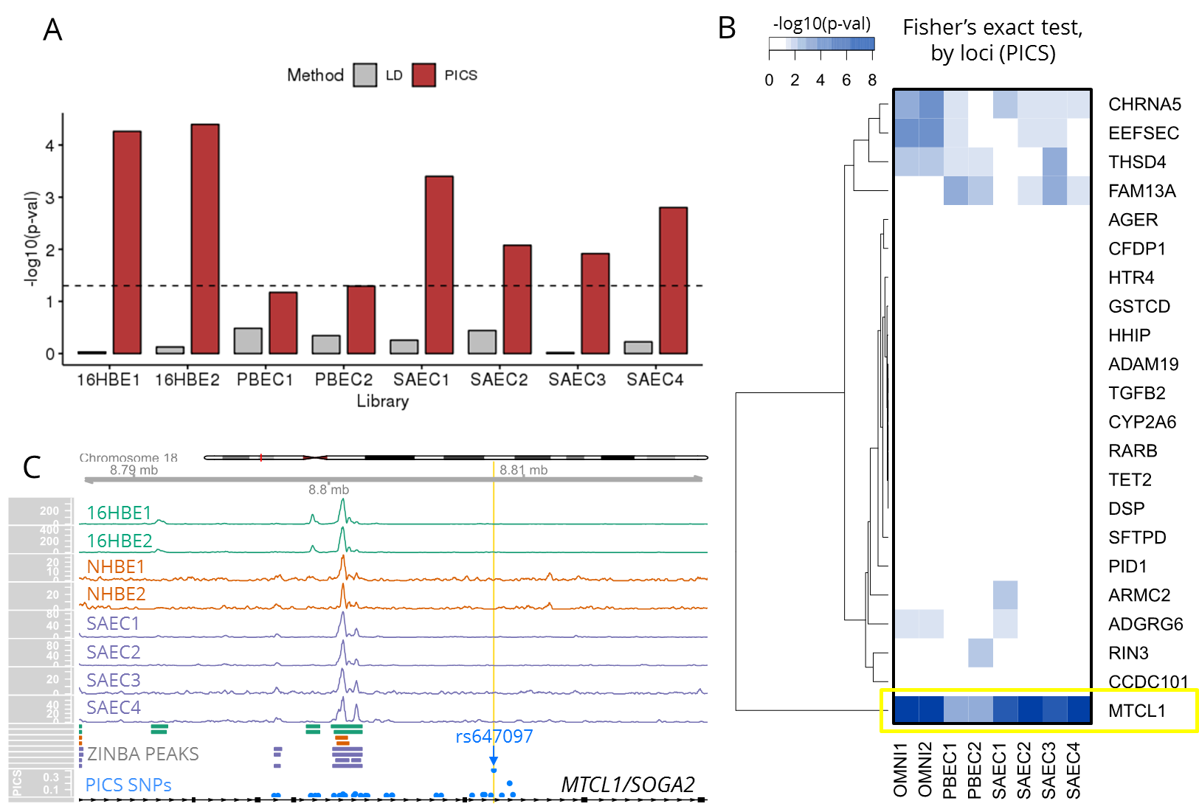
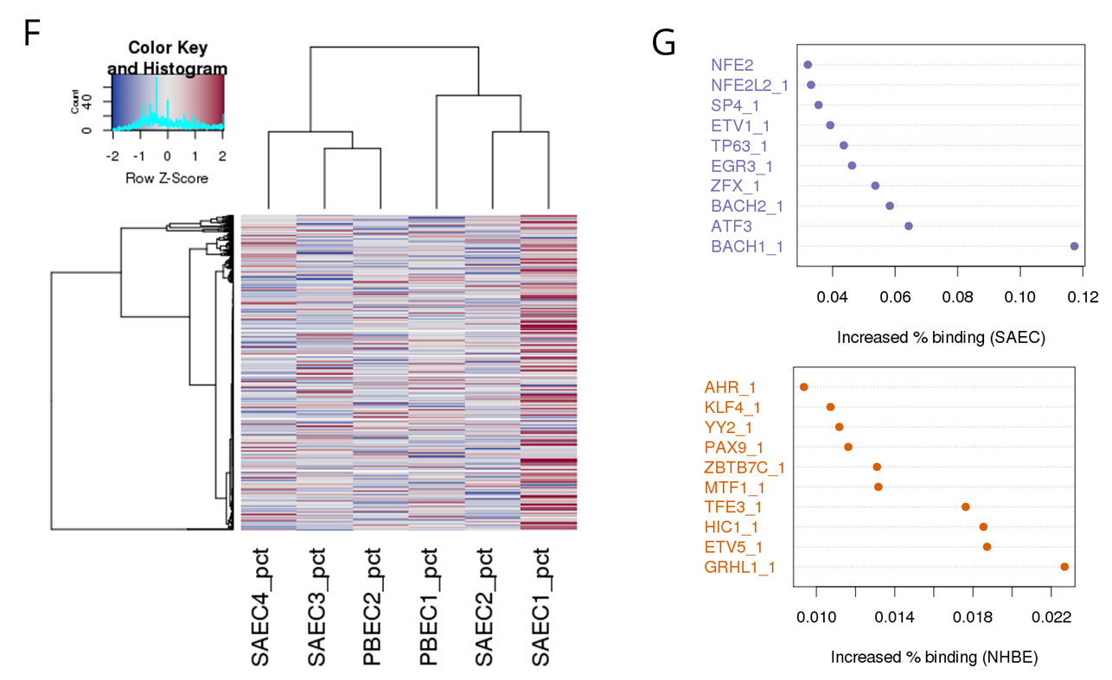
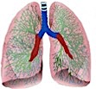
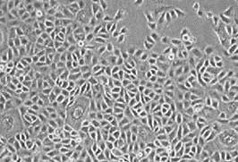
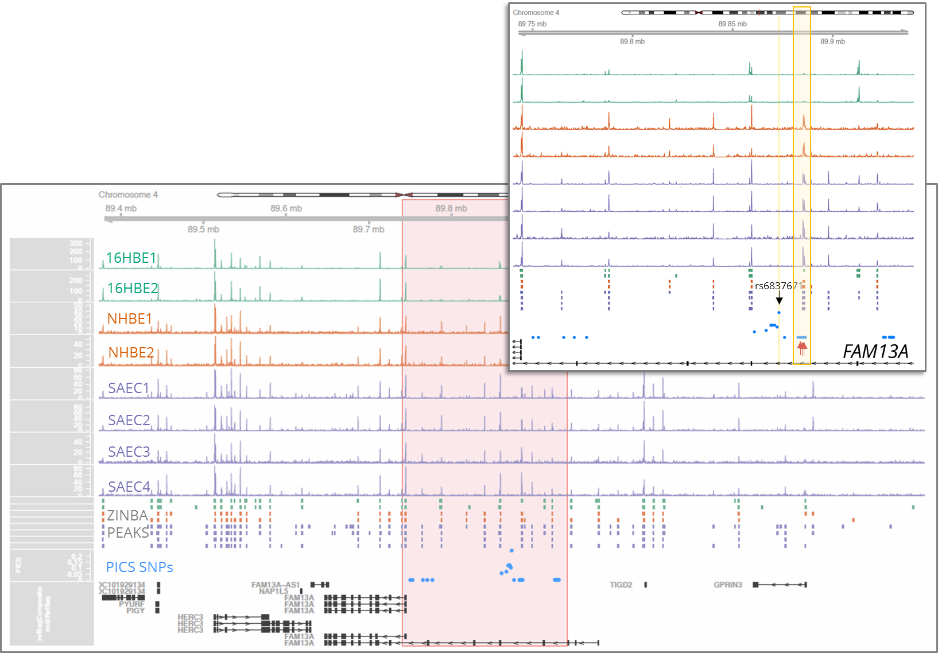
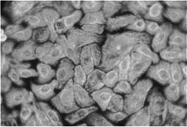
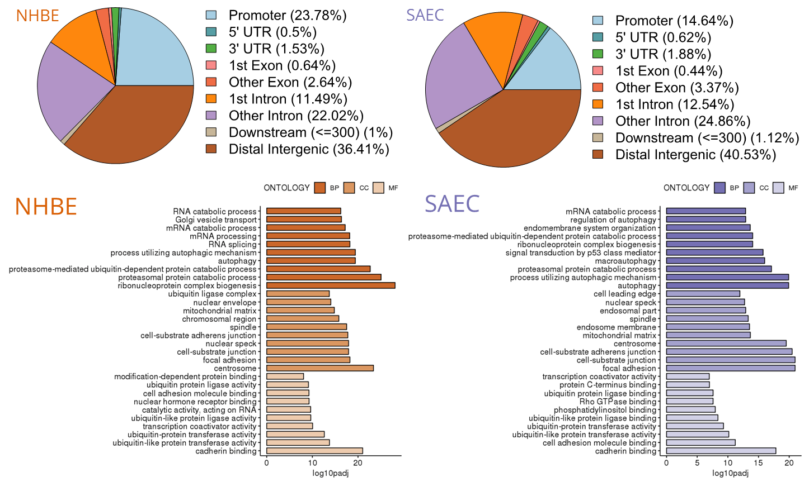
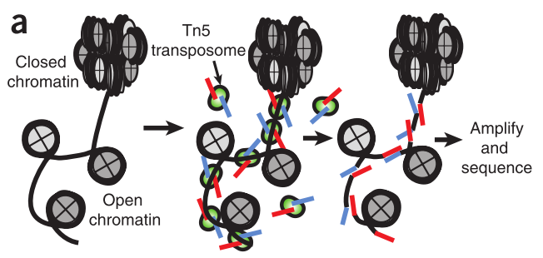
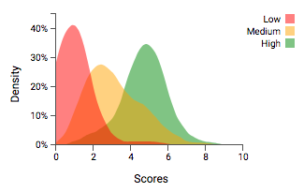
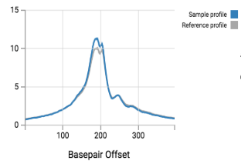
Chromatin accessibility landscapes of large and small airway cells
annotate multiple COPD susceptibility GWAS regions
`
Christopher J. Benway, Fei Du, Michael H. Cho, Edwin K. Silverman, Xiaobo Zhou
Channing Division of Network Medicine, Brigham and Women’s Hospital, Boston, MA
Abstract
Results I
Results II
Results III
Genome-wide association studies (GWAS) for chronic obstructive pulmonary disease (COPD) has identified many genetic variants associated with disease risk
We sought to functionally annotate COPD GWAS loci using chromatin accessibility profiling of small airway and bronchial epithelial cells from healthy human lungs
We compared ATAC-seq methods in a bronchial epithelial cell line
We then evaluated the enrichment of COPD GWAS variants in accessible chromatin in primary cells
Further, we profiled differences in chromatin accessibility between cell types and evaluated transcription factor (TF) footprinting
Omni-ATAC-seq outperforms Fast-ATAC-seq in 16HBE human bronchial epithelial cell line
Accessible chromatin in primary lung airway cells is enriched for COPD-associated variants
Differential chromatin accessibility and TF-footprinting in lung airway epithelium cells
Methods
Omni-ATAC-seq of primary lung airway epithelial cells functionally annotates COPD GWAS Loci
Genomic annotation and gene ontology analysis of accessible chromatin in primary lung epithelial cells
Bronchial/Tracheal Epithelial Cells
NHBE
Lung Small Airway Epithelial Cells
Lobar Bronchial Epithelial Cells
(Large Airway)
SAEC
Conclusions
Omni-ATAC-seq is a robust method for assaying chromatin accessibility in primary lung airway cell types; facilitates the functional annotation of candidate causal COPD GWAS SNPs. Differential accessibility analysis revealed differential open chromatin profiles in small and large airway cells ; transcription factor profiling at peaks reveals differential binding.
Notes:
Single sided poster!

Slide 2
Chromatin accessibility landscapes of large and small airway cells
annotate multiple COPD susceptibility GWAS regions
Christopher J. Benway, Fei Du, Michael H. Cho, Edwin K. Silverman, Xiaobo Zhou
Channing Division of Network Medicine, Brigham and Women’s Hospital, Boston, MA
Abstract
SCIENTIFIC ABSTRACT:
Genome-wide association studies (GWAS) have identified hundreds of genome-wide significant loci for respiratory disease. However, identification of causal variants and functional annotation in the appropriate cell type at these loci remain a major challenge. To gain a better understanding of chronic obstructive pulmonary disease (COPD) and other respiratory diseases, we sought to functionally annotate GWAS loci using chromatin accessibility profiling of small airway and bronchial epithelial cells from healthy human lungs.
We performed Omni-ATAC-seq in primary small airway epithelial cells (SAEC) and normal human bronchial epithelial cells (NHBE) as well as the 16HBE human bronchial epithelial cell line. We tested for enrichment of 22 COPD susceptibility GWAS loci in the accessible chromatin peaks. Sets of SNPs within GWAS loci were generated either by a heuristic or Bayesian fine-mapping approach. To aid in the functional annotation of COPD GWAS loci, we compared chromatin accessibility peaks and signals of these different cell types. We identified 9,112 differentially accessible peaks (FDR < 0.05) between large and small airway epithelial cells.
Further, we profiled genome-wide foot-printing of 533 transcription factors at accessible chromatin. Together, these cell-type specific chromatin accessibility profiles provide useful functional annotation of variants associated with COPD and respiratory disease and help prioritize experimental validation efforts.
LAY ABSTRACT:
While it is known that cigarette smoking is the number one risk factor for developing chronic obstructive pulmonary disease (COPD), genetic studies have identified numerous heritable factors associated with disease. However, it is not well understood how most of these genetic variants contribute to disease status.
To help discover how variation in these genomic regions can contribute to COPD we analyzed the accessibility of chromatin (packaged DNA) in human lung cells. We hypothesize that genetic variants located in chromatin regions which are more accessible in lung cells are more likely to have a functional role in gene regulation contributing to COPD.
We tested for enrichment of variants from 22 COPD susceptibility regions in accessible chromatin of two types of human lung cells connected to COPD disease: small airway epithelial and bronchial epithelial. To understand how these different cell types may contribute to disease we compared their chromatin accessibility.
Further, we profiled the transcription factor proteins which may bind to these accessible chromatin regions and lead to functional gene regulation of lung cells in COPD. Together, lung cell chromatin accessibility profiles help us better understand how genetic factors may contribute to COPD and which genes may play a role in disease.

Slide 3

Chromatin accessibility landscapes of large and small airway cells
annotate multiple COPD susceptibility GWAS regions
Christopher J. Benway, Fei Du, Michael H. Cho, Edwin K. Silverman, Xiaobo Zhou
Channing Division of Network Medicine, Brigham and Women’s Hospital, Boston, MA
Methods
Bronchial/Tracheal Epithelial Cells
Lung Small Airway Epithelial Cells
Lobar Bronchial Epithelial Cells (Large Airway)
isolated from epithelial lining of airways above bifurcation of the lungs
NHBE
Fast-ATAC-seq
Omni-ATAC-seq
Avg. nuclear reads/sample: ~15 M (aligned)
Adapter trimming
Alignment to hg19 (bowtie 1.0.1)
Filtering of mtDNA reads +
removal of duplicates (Picard 1.114)
Peak calling (ZINBA 2.02.04): windows of 300
bp with 75 bp overlap.
TF Foot-printing (PIQ v1.3)
isolated from normal human lung tissue the distal portion of the lung in the 1 mm bronchiole area
- 50,000 cells
-One-step permeabilization and transposition using digitonin
- 50,000 cells
-Permeabilization w/ NP40, Tween-20 and digitonin
-Tween-20 nuclei wash
-PBS and digitonin used in transposition
Culture in serum-free medium
SAEC
Omni-ATAC-seq optimization and comparison with Fast-ATAC-seq were conducted using the 16HBE human bronchial epithelial cell line originally established from normal bronchus tissue taken at lobectomy for squamous cell carcinoma (ATCC). This cell line has been transformed with the recombinant retrovirus LXSN16E6E7 containing the human papilloma virus (HPV) E6E7 gene. Primary normal human bronchial epithelial (NHBE) and small airway epithelial (SAEC) cells were obtained from Lonza.
Fast-ATAC-seq and Omni-ATAC-seq were performed as described in Corces et al. 2016 and Corces et al. 2017, respectively^{4,5}. Briefly, cell lines or primary cells were cultured in appropriate serum-free media and harvested by trypsinization at sub-confluency. 50,000 cells were permeabilized and transposed using the Nextera Tn5 Library Kit (Illumina).
ATAC-seq bioinformatic analysis was performed using the Epinomics end-to-end platform (alignment, peak calling, and footprinting. Subsequent analysis and visualization was conducted in Rstudio using the packages (Gviz, esATAC, ChIPseeker, ChIPpeakAnno, clusterProfiler, DiffBind, and DESeq2). COPD GWAS finemapping was conducted using summary statistics obtained from Hobbs et al 2017 and the PICS algorithm (Broad Institute)^{2,6}. Fisher exact test was performed using ‘bedtools.’

Slide 4
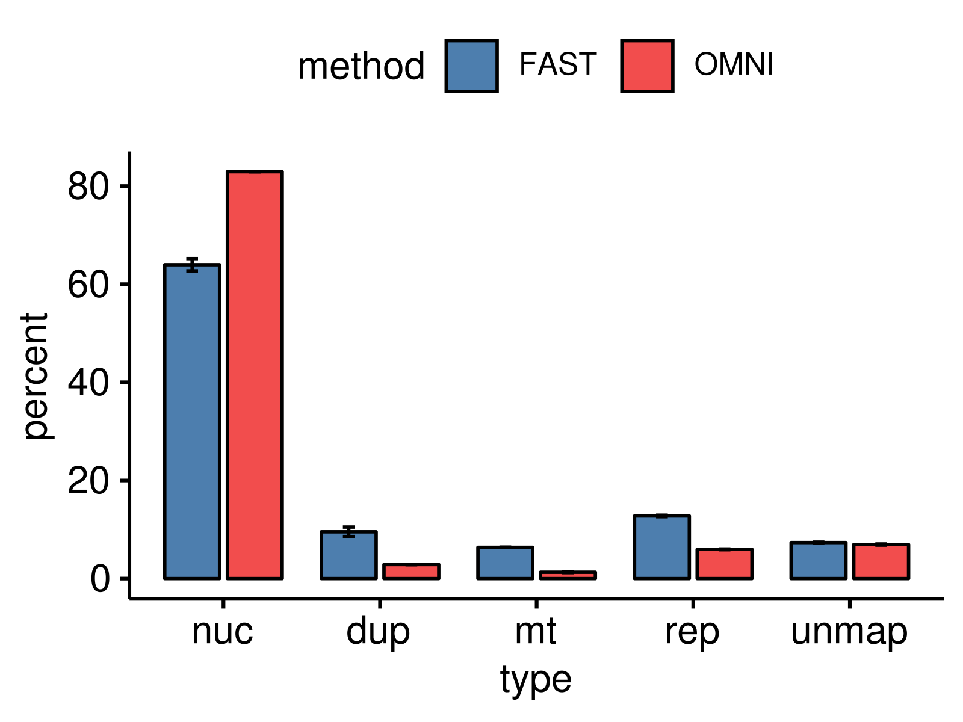
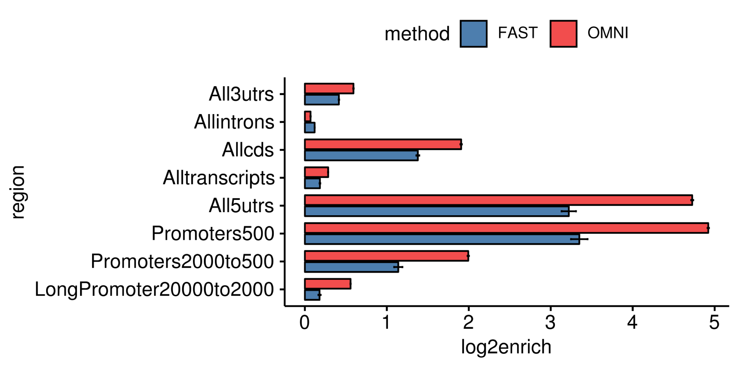
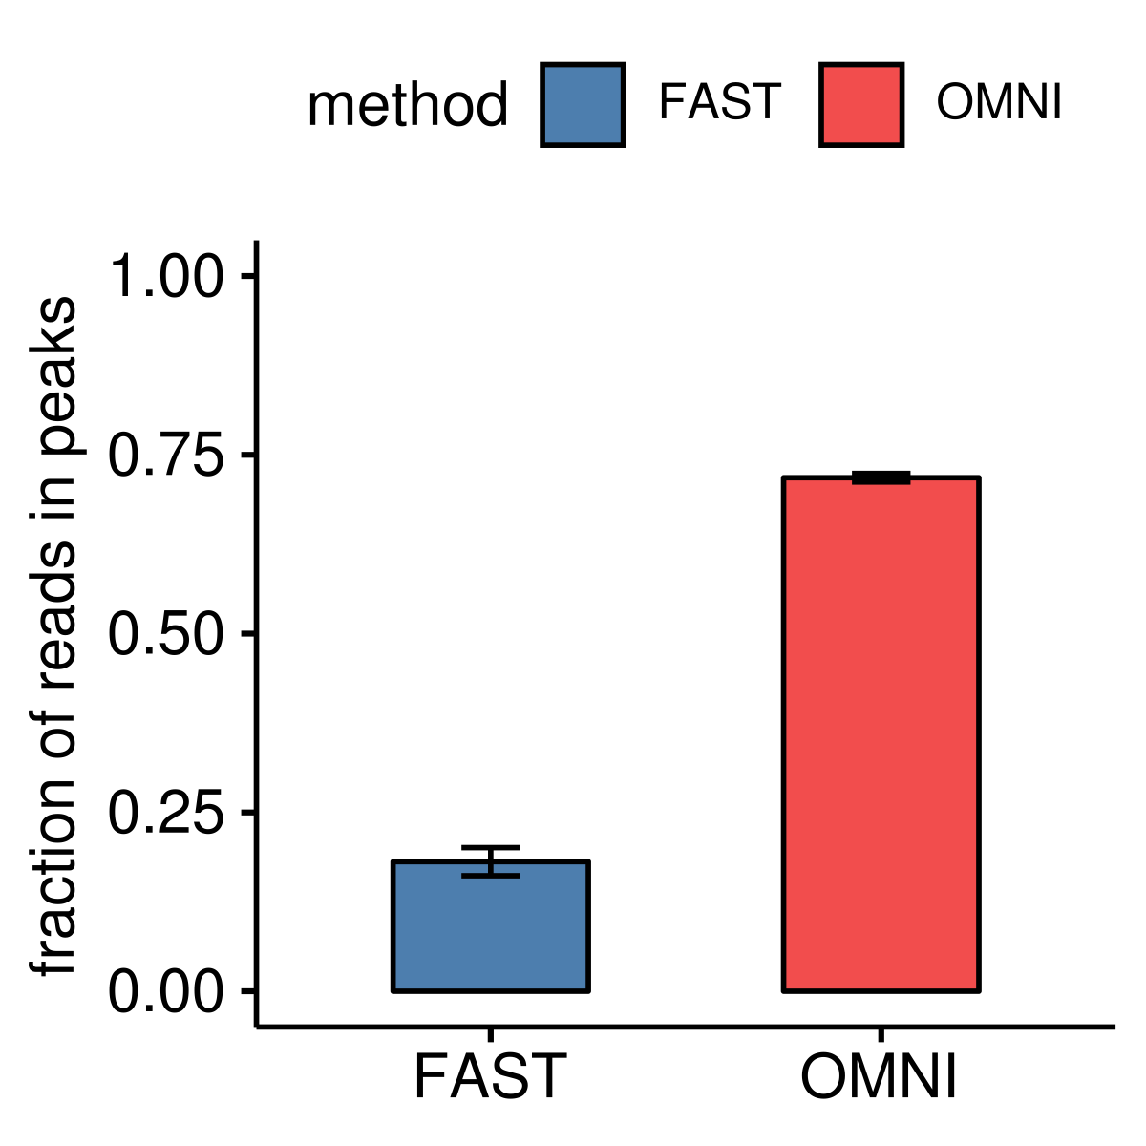
Chromatin accessibility landscapes of large and small airway cells
annotate multiple COPD susceptibility GWAS regions
Christopher J. Benway, Fei Du, Michael H. Cho, Edwin K. Silverman, Xiaobo Zhou
Channing Division of Network Medicine, Brigham and Women’s Hospital, Boston, MA
Omni-ATAC-seq outperforms Fast-ATAC-seq in 16HBE human bronchial epithelial cell line
Omni-ATAC-seq of primary lung airway epithelial cells functionally annotates COPD GWAS Loci
A
B
16HBE1
16HBE2
NHBE1
rs6837671
NHBE2
FAM13A
SAEC1
SAEC2
C
D
SAEC3
SAEC4
ZINBA
PEAKS
PICS SNPs
FAM13A
Open chromatin profiles of 16HBE, NHBE, and SAEC cells at the FAM13A locus. PICS fine-mapping of the lead COPD-associated SNP⁶, rs6837671, identified 35 candidate causal variants variants at the locus, of which three (rs2013701, rs2904259, rs4693980) overlapped with ATAC peaks. SNPs previously associated with COPD and lung function phenotypes (rs28459962, rs2013701, rs2904259, and rs4693980) map to the same NHBE/SAEC open region^{1,3}.
In 16HBE human bronchial epithelial cell line, the optimized Omni-ATAC-seq protocol, compared to Fast-ATAC-seq: (A) increased nuclear reads and decreased contaminant mitochondrial reads sequenced, (B) increased signal-to-background (“fraction of reads in peaks”), (C) increased signal at transcription starts sites, and (D) increased enrichment of reads mapped to transcripts, promoters, and distal promoters.

Slide 5
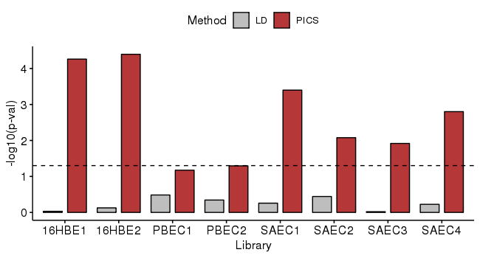
Chromatin accessibility landscapes of large and small airway cells
annotate multiple COPD susceptibility GWAS regions
Christopher J. Benway, Fei Du, Michael H. Cho, Edwin K. Silverman, Xiaobo Zhou
Channing Division of Network Medicine, Brigham and Women’s Hospital, Boston, MA
Accessible chromatin in primary lung airway cells is enriched for COPD-associated variants
Genomic annotation and gene ontology analysis of accessible chromatin in primary lung epithelial cells
A
B
-log10(p-val)
Fisher’s exact test,
by loci (PICS)
NHBE
SAEC
NHBE
SAEC
C
16HBE1
16HBE2
NHBE1
NHBE2
SAEC1
SAEC2
SAEC3
SAEC4
ZINBA PEAKS
rs647097
PICS SNPs
MTCL1/SOGA2
(A) Credible sets computed using PICS fine-mapping of 22 COPD-associated loci were enriched in open chromatin regions in lung airway cells. (B) The most significant overlap was at the MTCL1/SOGA2 locus, where as many as 11 of 28 SNPs in the credible set were located in open chromatin regions. (C) The overlapping peak is located in the intronic region of MTCL1/SOGA2.
Left, open chromatin peaks in both NHBE and SAEC cell types were primarily located in promoter or intronic regions of transcripts. Representative pie charts of the libraries are depicted. Across replicates the proportions were comparable between cell types. Right, GO analysis for the genes nearest promoter and intron peaks identifies the most enriched biological processes, cellular compartments, and molecular functions in lung airway epithelial cells.

Slide 6
Chromatin accessibility landscapes of large and small airway cells
annotate multiple COPD susceptibility GWAS regions
Christopher J. Benway, Fei Du, Michael H. Cho, Edwin K. Silverman, Xiaobo Zhou
Channing Division of Network Medicine, Brigham and Women’s Hospital, Boston, MA
Differential chromatin accessibility and TF-footprinting in lung airway epithelium cells
A
B
C
F
SAEC
NHBE
N = 11,293
N = 70
D
E
KEGG
G
Reactome
(A) Pearson correlation of chromatin accessibility landscapes in primary human lung airway cells versus the 16HBE bronchial epithelial cell line. (B) Heatmap of differentially accessible peaks in the primary lung cell types. (C) Volcano plot of differentially accessible peaks demonstrating that distribution of significant peaks is largely comprised of SAEC peaks. (D) Gene ontology analysis for SAEC peaks located in promoter or intron regions; BP = biological process, CC = cellular compartment, MF = molecular function. (E) Pathway enrichment analysis for SAEC peaks located in promoter or intron regions. (F) Genome-wide transcription factor (TF) profiling of 533 proteins reveals sample-specific occupancy profiles (Z-scores represent percent of total sites bound, scaled by row). (G) BACH1 transcription factor displayed 12% increased binding in SAEC compared to NHBE.
r

Slide 7
Chromatin accessibility landscapes of large and small airway cells
annotate multiple COPD susceptibility GWAS regions
Christopher J. Benway, Fei Du, Michael H. Cho, Edwin K. Silverman, Xiaobo Zhou
Channing Division of Network Medicine, Brigham and Women’s Hospital, Boston, MA
Conclusions
Omni-ATAC-seq is a robust method for assaying chromatin accessibility in primary lung airway cell types. We report that Omni-ATAC-seq in these cells outperformed previous ATAC protocols in terms of enrichment of nuclear reads, reduction of mitochondrial reads, increased signal-to-background, increased enrichment at transcription start sites and annotated transcript regions.
Omni-ATAC-seq facilitates the functional annotation of candidate causal COPD GWAS SNPs. Within GWAS loci associated with COPD disease status and related lung function phenotypes, we observed several open chromatin regions in lung airway cells flanking lead SNPs. Using probabilistic fine-mapping we also identified several candidate causal SNPs directly overlapping ATAC peaks in COPD associated loci.
Differential accessibility analysis revealed differential open chromatin profiles in small and large airway cells. Despite the overall similarity of the open chromatin profiles between cell types, we identified over 11,000 differentially open regions in small airway cells. Ontology analysis suggests these elements regulate cell junction and adhesion processes and actin binding.
Transcription factor profiling at accessible peaks reveals differential binding. BACH1 demonstrated increased binding in small airway compared to large airway cells.

